Slide 1
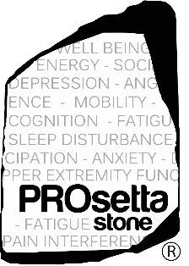
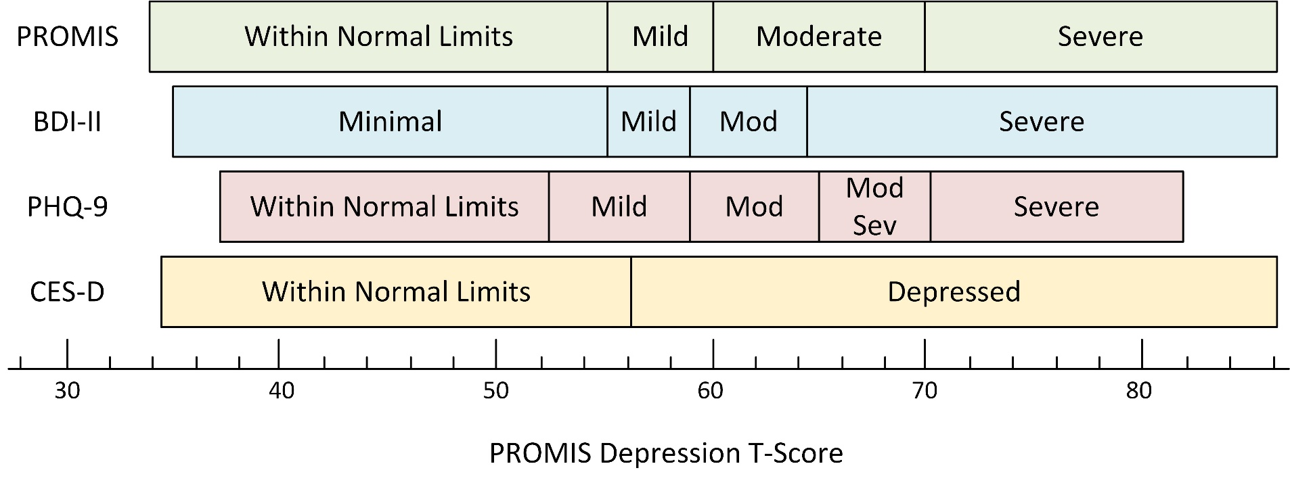
PROsetta Translates Score Thresholds
Choi, Schalet, Cook, Cella, Psychological Assessment 2014
www.HealthMeasures.net/score-and-interpret/linking-measures

